Slide 1

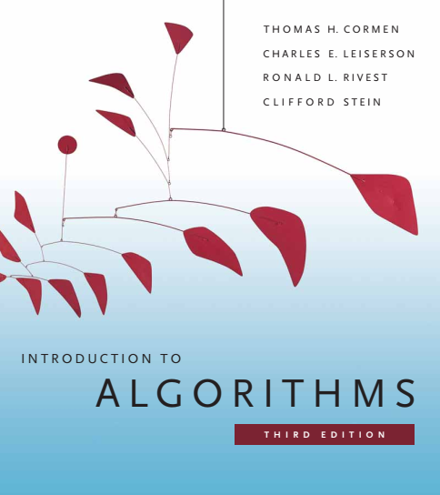
Design and Analysis of Algorithms
Dr. Sajid Iqbal
Reference Book
Introduction to Algorithms 3rd Edition By Thomas H. Cormen et. al.
https://mitpress.mit.edu/books/introduction-algorithms-third-edition
COMEDXD

Slide 2
Elementary Data structures
A review

Slide 3
What is Data
A set is a collection of distinct objects, called elements of the set
Sets are as fundamental to computer science as they are to mathematics.
Mathematics has well defined sets with well defined elements
Static sets only
Computer science has
Static Sets: Sets that are well defined and have fixed amount of elements
Dynamic Sets: Well defined sets that may increase or decrease elements during execution of program

Slide 4
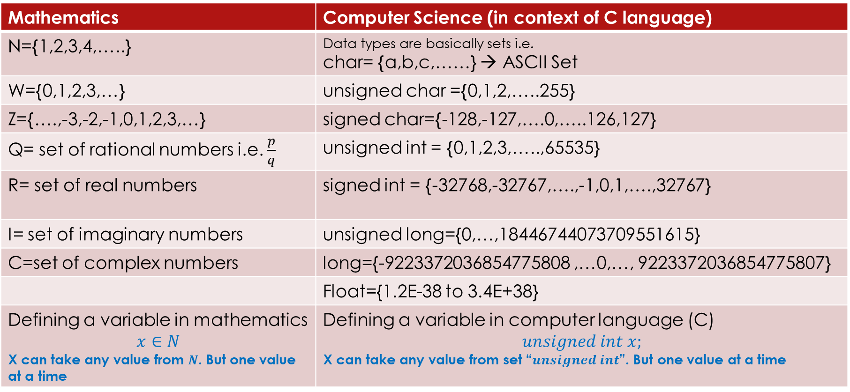
Sets and Data structures
Mathematics | Computer Science (in context of C language)
N={1,2,3,4,…..} | Data types are basically sets i.e. char= {a,b,c,……} → ASCII Set
W={0,1,2,3,…} | unsigned char ={0,1,2,…..255}
Z={….,-3,-2,-1,0,1,2,3,…} | signed char={-128,-127,….0,…..126,127}
Q= set of rational numbers i.e. $\frac{p}{q}$ | unsigned int = {0,1,2,3,…..,65535}
R= set of real numbers | signed int = {-32768,-32767,….,-1,0,1,….,32767}
I= set of imaginary numbers | unsigned long={0,…,18446744073709551615}
C=set of complex numbers | long={-9223372036854775808 ,…0,…, 9223372036854775807}
 | Float={1.2E-38 to 3.4E+38}
Defining a variable in mathematics $$x∈N$$ X can take any value from $N$. But one value at a time | Defining a variable in computer language (C) $$unsigned int x;$$ X can take any value from set “$unsigned int$”. But one value at a time
http://www.asciitable.com/
http://home.ku.edu.tr/~amostafazadeh/math107/F2012/Handouts/Sets%20from%20Wikipedia_2012_09_18.pdf

Slide 5
What are Data Structures
A specialized way to organize, process, store and retrieve data is called a data structure
There are multiple ways to manage data i.e. multiple data structures
Usually different data structures are useful to solve specific type of problems efficiently
it is important to choose the proper data structure for each task.
Like algorithms, choosing an ill-suited data structure could result in slow runtimes or unresponsive code.
Data Structure Specification
Information about the data values
Relationships between the data
Functions that can be applied to the data

Slide 6
Basic Data structures
A data type can also be considered as data structure.
Basic data structures in programming language C are
Static basic data structures
Char, Int, float, double
Static composite data structures
Arrays, Structures, enumerations
Computer Science allows you to build your own sets (data structures)
Static data structures
Dynamic data structures

Slide 7
Characteristics of data structures
Data structure types
Primitive data structures
Integer
Real
Derived data structures
Character
Boolean
Linear Data structures
Non-linear data structures
Arrays
Stacks
Linked Lists
Queues
Tree
Graph
Hash Tables
Types of data structures
Language defined – User defined
Linear – non linear
Homogeneous - heterogeneous
Static - dynamic
Uses of data structures
Any computer program that deals with data uses data structures
i.e. Without data structure no data processing is possible

Slide 8

Static Data Structures
Homogeneous (Primitives or composites)
Scalars: Boolean, char, int, float, double
Vectors: 1D Arrays
Tensors: Multidimensional arrays
For Scalar Data Structure x;
Information about data values $=\{−32768,….,0,….,32767\}$
Relationship between the data $−32768<−32767<−32766…$
Functions or operations: $addition, multiplication, …..$
unsigned int x;
int y[5]={1,2,3,4,5};
struct Student{
int rollno;
char name[20];
float marks;
};
Student std;

Slide 9
Static data structure
Arrays
int arr[10]
Data items: items from set “int”
Relationship: an ordered relationship as for scalar
Function: element wise operations, indexing, ….
Structures
struct Student std
struct Student stds[3]
Index | 0 | 1 | 2 | 3 | 4 | 5 | 6 | 7 | 8 | 9
value | 9 | 7 | 8 | 4 | 3 | 3 | 9 | 0 | 2 | 1
0 | 1 | 2
struct Student
{
int rollno;
char name[20];
float marks;
};

Slide 10
Dynamic Data structure
Operations on Dynamic Sets
Elements of a dynamic set (DS)
Each element of dynamic dataset element is represented by an object
Attributes of that object can be examined and manipulated with the help of pointer
A DS may have elements in the form of key-value pairs
Value is key-value pair is also known as satellite data
In addition to usual operations, new operations may be defined for dynamic sets
Search(S,k)
Insert (S,x)
Delete(S,x)
Minimum(S)
Maximum(S)
Successor(S,x)
Predecessor(S,x)
Parent (S,x)

Slide 11

Dynamic Data Structures
Stacks
A stack is considered as LIFO (Last in First out) List
Data Items: Anything that we define i.e. integers ,reals, structures, objects, ….
Relationship: The sequence of insertion of data items, which came first and which came next
Functions
Operations
Insert/Push: We define that Insert operation always inserts an element at the top of list
Delete/Pop: We define that delete operation always deletes an elements from top of list
Properties:
Empty: When there is no item in the stack - underflow
Full: When the specified capacity is filled - overflow

Slide 12

Stack Operations
Algorithm Analysis
Stack_Empty
$C_{1}+c_{2}+c_{3}=C=1$
Push
$C_{1}+C_{3}+C_{4}=C=1$
Pop
$C_{1}+C_{3}+C_{4}=C=1$
Stack_Empty(S)
If S.top==0
Return true
Else
return false
 | 0 | 1 | 2 | 3 | 4 | 5 | 6 | 7
S
 | ↑
 | s.top
Push(S, x)
If S.top==S.length+1
Return -1
Else
S[S.top]=x
S.top++
return 0
 | 0 | 1 | 2 | 3 | 4 | 5 | 6 | 7
S | 8 | 1 | 5
 |  |  |  | ↑
 |  |  |  | s.top
 | 0 | 1 | 2 | 3 | 4 | 5 | 6 | 7
S | 8 | 1 | 5 | 6 | 7 | 8 | 9 | 6
 |  |  |  |  |  |  |  |  | ↑
 |  |  |  |  |  |  |  |  | s.top
Pop(S)
if Stack_Empty(S)
return “underflow”
else
S.top=S.top-1
return S[S.top]

Slide 13

Queues
First in first out list (Q) – FIFO
Two pointers are maintained: Q.head and Q.tail
Operations:
Insert/Enqueue: Inserting the element at the tail of list
Delete/Deque: Removing an element from head of list
Properties:
Empty: There is no element in the list
Filled: Allocated space is filled and no room for next element

Slide 14










Queue Operations
Q.tail
Q.head
Insert
Delete
$$↓$$
$$↓$$
5
4
y
x
Q.tail
Q.head
$$↓$$
$$↓$$
3
5
4
y
x
Q.tail
Q.head
$$↓$$
$$↓$$
x
3
5
4
y
Q.tail
Q.head
$$↓$$
$$↓$$
5
3
Q.head
Q.tail
$$↓$$
$$↓$$
3

Slide 15
Operations on Queue
Enqueue(Q,x)
1 | Q[Q.tail]=x
2 | Q.tail=Q.tail-1
Dequeue(Q)
1 | X=Q[Q.head]
2 | Q.head=Q.head-1
3 | return x
Enqueue(Q,x)
1 | Q[Q.tail]=x
2 | if Q.tail == Q.length
3 | Q.tail = 1
4 | else Q.tail = Q.tail + 1
Dequeue(Q)
1 | X=Q[Q.head]
2 | if Q.head == Q.length
3 | Q.head = 1
4 | else Q.head = Q.head + 1
5 | Return x

Slide 16

Thanks for watching
Dr. Sajid Iqbal
Assistant Professor
Department of Computer Science
Bahauddin Zakariya University, Multan
sajidiqbal.pk@gmail.com
Youtube Channel: COMEDXD
Allah Hafiz

